Slide 1
Airbnb New User Booking - Case Study
Lamyaa Zayed

Slide 2
AGENDA:
Problem Definition and Key Findings
Modeling and Results
Business Insights
1
2
3
4
5
Visualization
Technical Aspects

Slide 3

Airbnb
Airbnb, headquartered in San Francisco, operates a global online marketplace and hospitality service accessible via its websites and mobile apps.
Airbnb is an online marketplace which lets people rent out their properties or spare rooms to guests. Airbnb takes 3% commission of every booking from hosts, and between 6% and 12% from guests.
New users on Airbnb can book a place to stay in 34,000+ cities across 190+ countries. By accurately predicting where a new user will book their first travel experience.
Airbnb can share more personalized content with their community, decrease the average time to first booking, and better forecast demand.

Slide 4
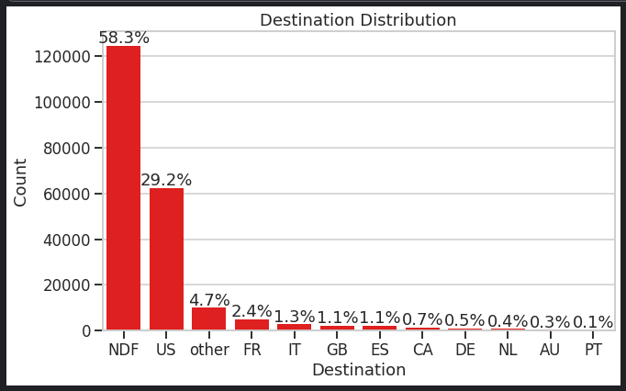
Frame the Problem
Target is to predict which country a new user's first booking destination will be.
There are 12 possible outcomes of the destination country: 'US', 'FR', 'CA', 'GB', 'ES', 'IT', 'PT', 'NL','DE', 'AU', 'NDF' (no destination found), and 'other'.
Here will demonstrate the entire process to suggest the first destination of new Airbnb Users. All the processes involved, such as data wrangling, exploratory data analysis, inferential statistics and machine learning.BI6

Slide 5
Data Wrangling
In the first section, I will attempt at cleaning the Airbnb Data and wrangling into a form that is suitable for further analysis.
The first step is to load all the data available and extract basic information such as number of samples, number of null values rows, number of features, etc.
The next step would be to deal with the missing values using a suitable method (dropping, imputing, etc.) and convert certain features into a more suitable form for applying inferential statistics and machine learning algorithms.

Slide 6
Users train/test Files (213,451 x 16)/(62,096 x 15) shape
Data: Following are the ‘15 features’ and ‘target’ present in training dataset:
Dataset Link on kaggle: https://www.kaggle.com/c/airbnb-recruiting-new-user-bookings/data
id | date_account_created | first_browser | first_device_type
age | timestamp_first_active | signup_flow | affiliate_channel
gender | date_first_booking | Signup_app | first_affiliate_tracked
language | country_destination | signup_method | affiliate_provider

Slide 7



EDA and Feature Engineering for User’s data
First check for missing values on data:
So need to handle the features which have Null values: ‘date_first_booking’ , ‘first_affiliate_tracked’ and ‘age’.

Slide 8
Missing Values Handling and Imputing
As we see that the column “date_first_booking ” has 58.35% nulls on the train set and 100% nulls on the test set. So we can simply ‘Drop’ this feature.
Also based on that the nulls of “first_affiliate_tracked” is about 2.84% on train set and 0.03% on test set, so we can impute this feature by ‘Mode’: ‘untracked’ as its a categorical one, skewed and data had a lot of outliers.
Finally for “age” column which has 41.22% nulls on train set and 46.5% nulls on test set, so i found that the best technique to impute this feature is to ‘Predict’ its missing values by model with the non-missing features.

Slide 9
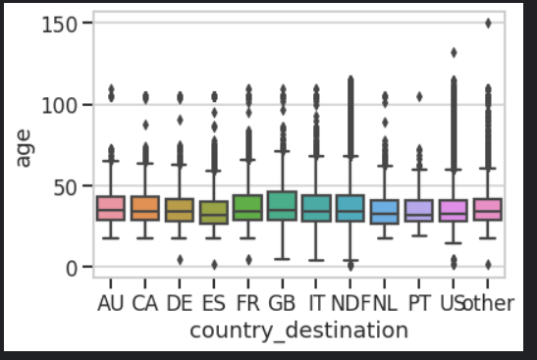
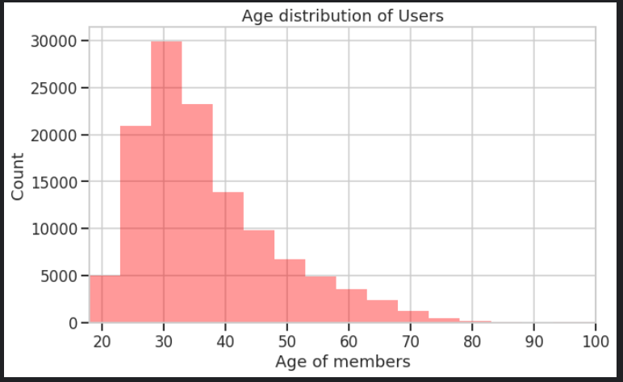
Age Feature Imputation
We notice that there are samples for which the age is much greater than 120.
Most Engaged Age Group is from 30 to 50.
This is clearly polluted data and must be removed. Let us replace these values outside the interquartile range IQR with NaN to denote that we do not know the real age of these people and predict the missing values for all of them.BI8

Slide 10
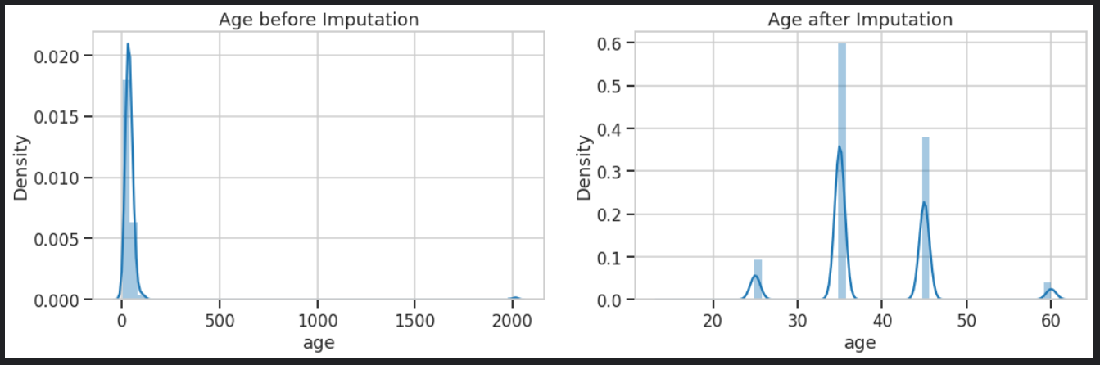
Age Feature Imputation
So after filling nulls here with RandomForestClassifier, here are the results before and after imputations.BI9

Slide 11
Gender Feature
let us check if there is a gender based preference for certain countries. In other words, does the gender of a person affect the first country s/he books an Airbnb in?
To answer this question we will have to test the relationship between two categorical variables: Gender and Destination Country. Since the number of destination countries is multivariate, the Chi-Square Test for Feature selection.
For the hypothesis testing, we define the following:
Null Hypothesis: There is no relationship between country preference and the gender of the customer (independent).
Alternate Hypothesis: There is a relationship between country preference and the gender of the customer (not independent).
We will assume our significance level, α to be 0.05.

Slide 12
Gender Feature
After applying the “stats.chi2_contingency(observed)” test, found that the P-value is ‘5.8301269550715721e-21’.
So the p-value that we have obtained is less than our chosen significance level. Therefore, we reject the null hypothesis Ho and accept the alternative hypothesis as has evidence and confident for Ha. There is a relationship between country preference and the gender of the customer.
Then we can go with this feature to help on prediction process.

Slide 13
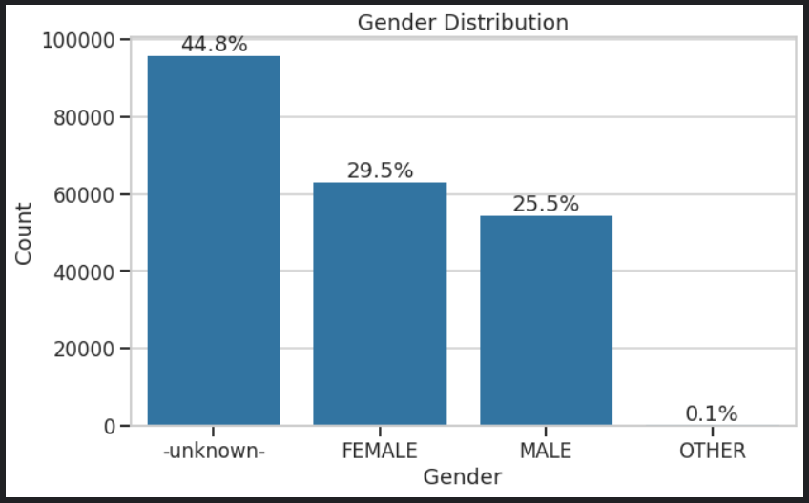
Gender Feature
As we see that there are ‘unknown’ and ‘other’ values at which will not help and mislead in prediction process, so i will replace these two values with nulls, and then impute these missing values by predicting them with non-missing features as we done with the age column.BI10
Females are relatively higher than males.

Slide 14
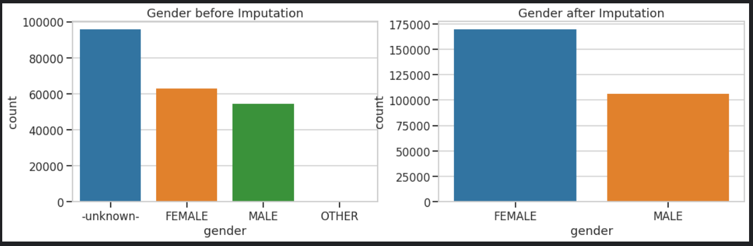
Gender Feature
So after filling nulls here with RandomForestClassifier, here are the results before and after imputations.

Slide 15
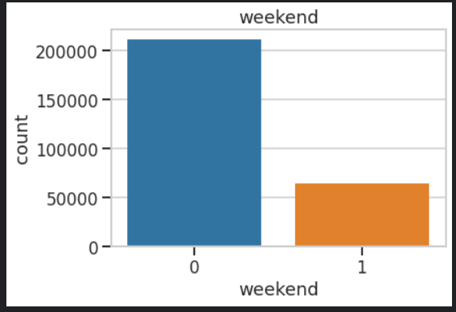
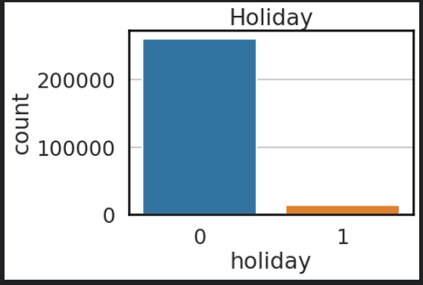
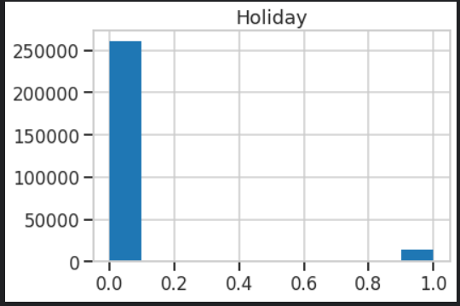
Adding Weekend and Holiday Features
Adding ‘weekend’ and ‘holiday’ features may help to increase some information to the model and predict the new first country target better.
Create holiday feature by scraping the holidays informations from web page by BeautifulSoup from https://www.timeanddate.com/calendar/custom.html site.

Slide 16
Signup method Feature
This feature tells us that most users sign up either through the standard basic method or through Facebook. Additionally, they login using either a desktop browser, a mobile browser or a mobile app.
Does the type of device (mobile or computer) affect the signup method to Airbnb? Again, as before with gender with chi-square test..
After applying the “stats.chi2_contingency(observed)” test, found that the P-value is ‘0.78867886610237792’.
The p-value obtained is higher than our chosen significance level. Therefore, we cannot reject the null hypothesis. It stands. There is no relationship (independant) between device type and signup method.

Slide 17
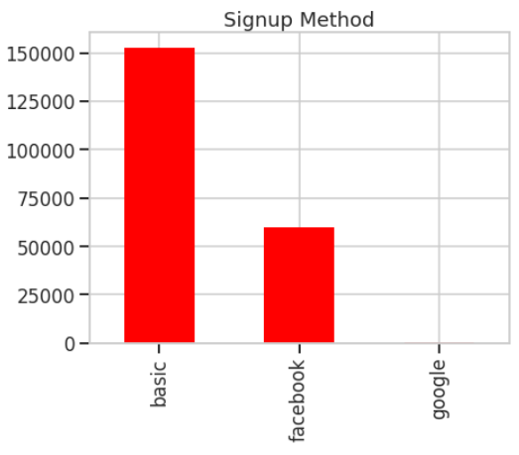
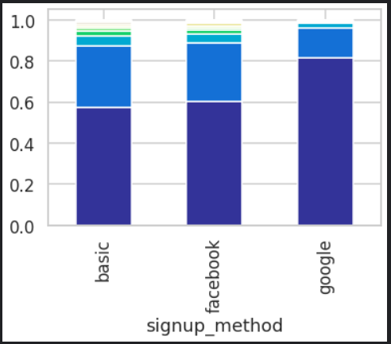
Signup method Feature
We discover that people who use basic signup method are most likely to book an Airbnb whereas people who use google are least likely to make a booking.

Slide 18
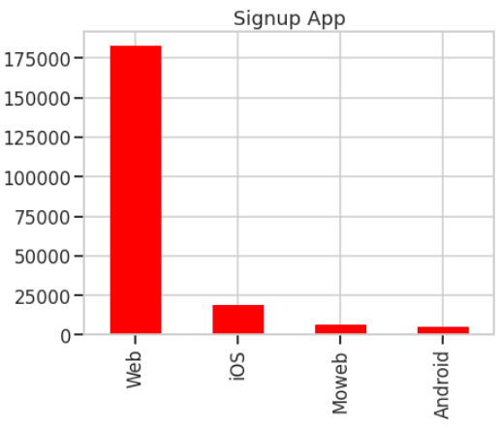
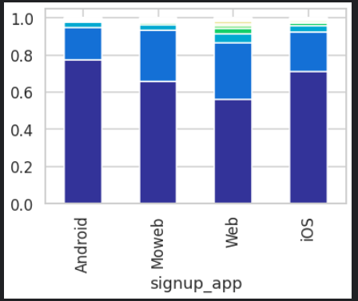
Signup App Feature
Most Users Sign Up Using the Basic websites or their facebook accounts , and most of them use the web version as signup app.BI14

Slide 19
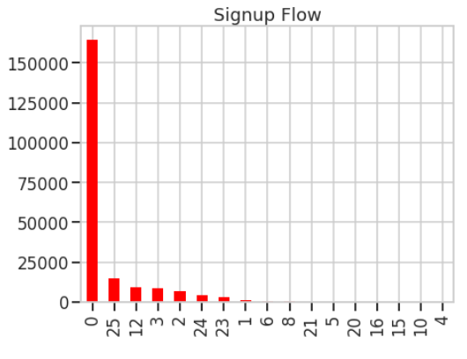
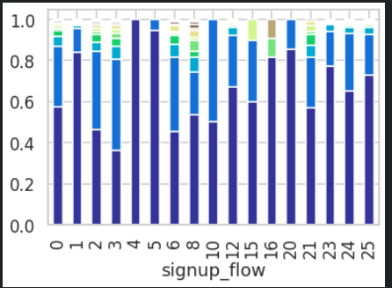
Signup Flow Feature
Signup flow contains the page a user came to signup up from.
people with signup flow 3 are most likely to book an Airbnb. Conversely, people with signup flows 4 and 5 are least likely to convert.BI4

Slide 20
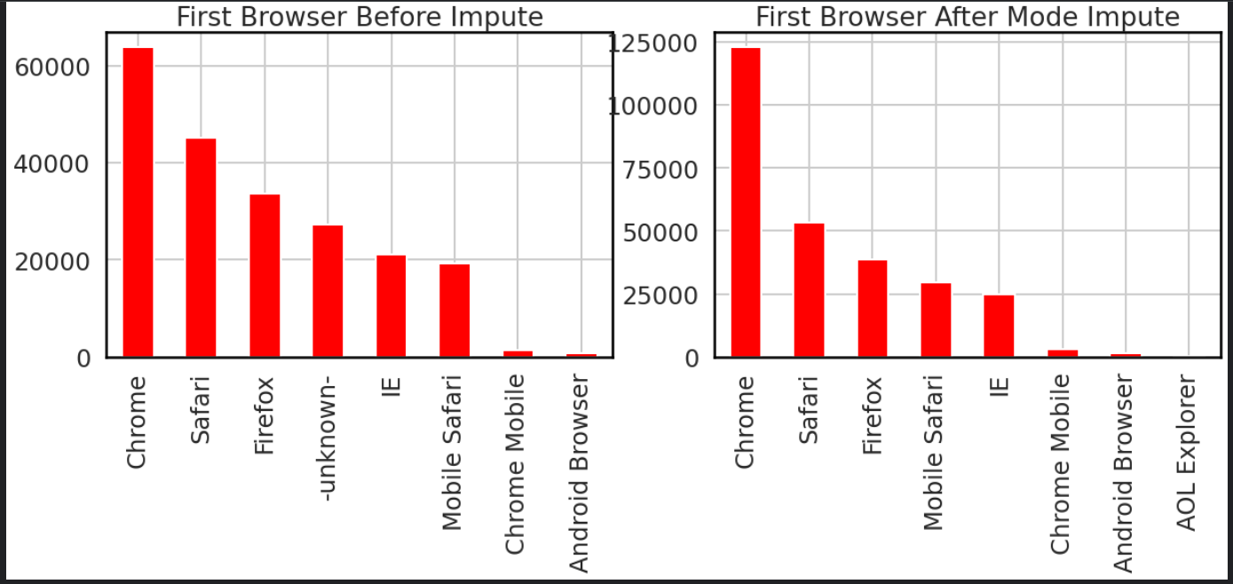
First Browser Feature
Replace 16% _unknown_ with nulls and then impute these null values with ‘Mode’ as this feature is skewed and categorical.
There are the feature distribution before and after imputation.

Slide 21
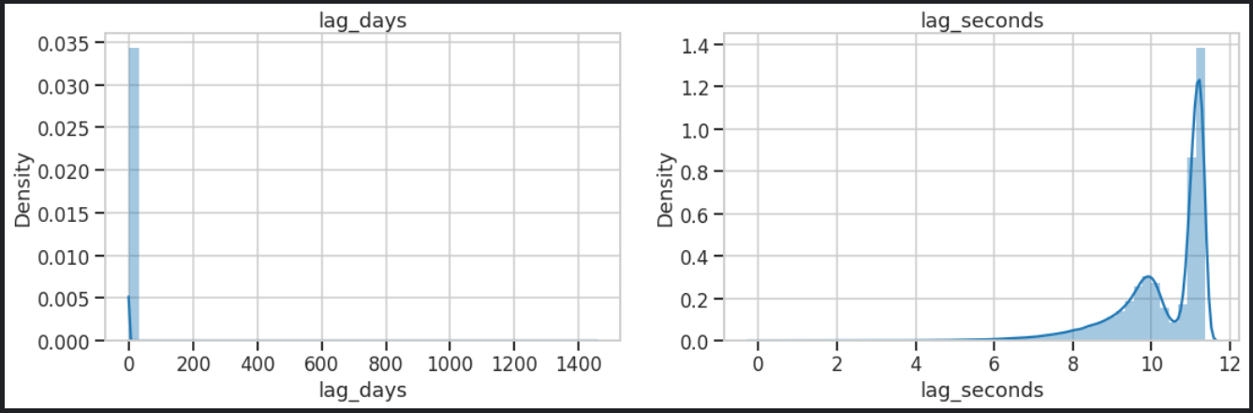
Lagging Time
A “lag” is a fixed amount of passing time; One set of observations in a time series is plotted (lagged) against a second, later set of data.
Helps to identify patterns within the time series technique, which is a tendency for the values within a time series to be correlated with previous copies of itself.
Create ‘lag_days’ and ‘lag_seconds’ features from the time lagging between ‘timestamp_first_active’ and ‘date_account_created’ columns, Just take ‘lag_seconds’.

Slide 22
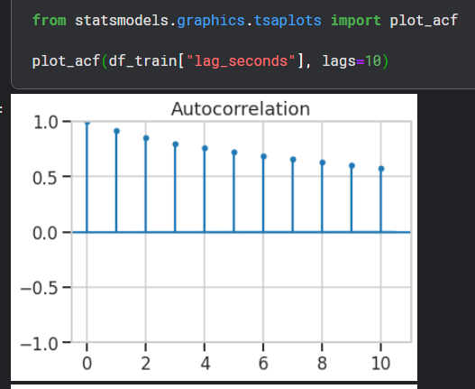
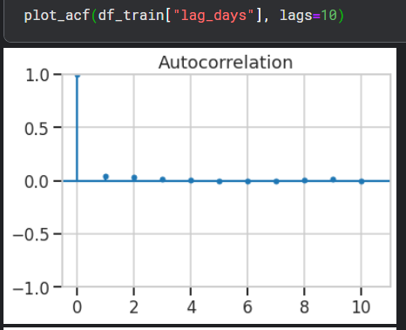
Lagging Time
The autocorrelation function for ‘lag_seconds’ shows a slow decay, which means that the future values have a very high correlation with its past values.
The number of times you shift, the same number of values will be reduced from the data. You would see some rows with NaNs at the start. That’s because the first observation has no lag. You’ll need to discard these rows from the training data.
Lag_seconds here is shifted by one.

Slide 23
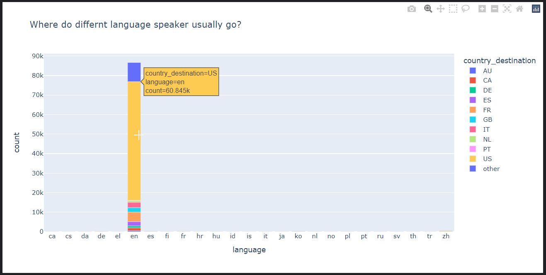
Language Feature
Language feature vs target countries, found that the majority are English speakers.

Slide 24
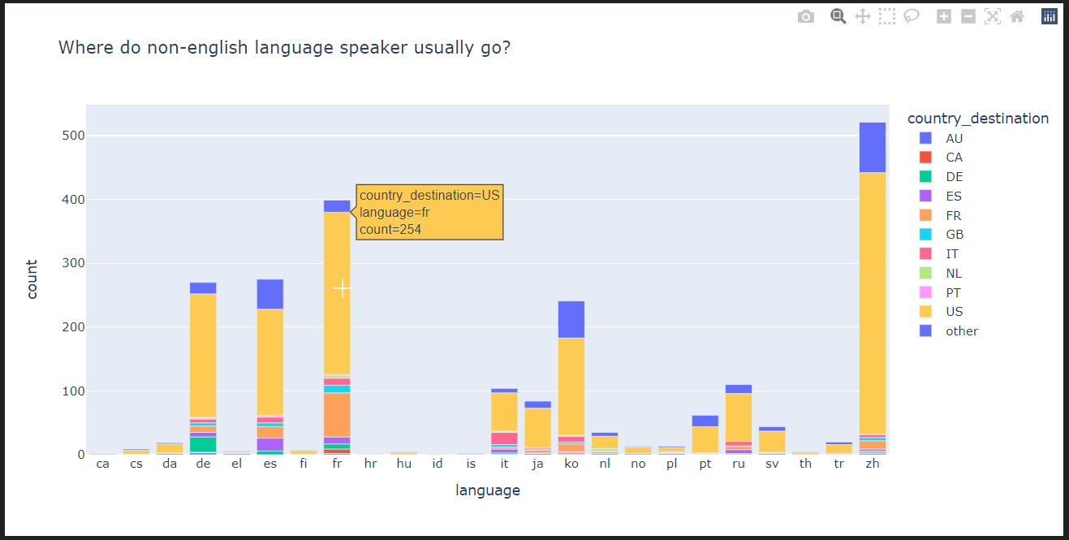
Language Feature
Language feature vs target countries, without ‘en’ to see other languages aspects.
However since the users are American, we can safely assume that the non English users constitute a minority.BI1

Slide 25
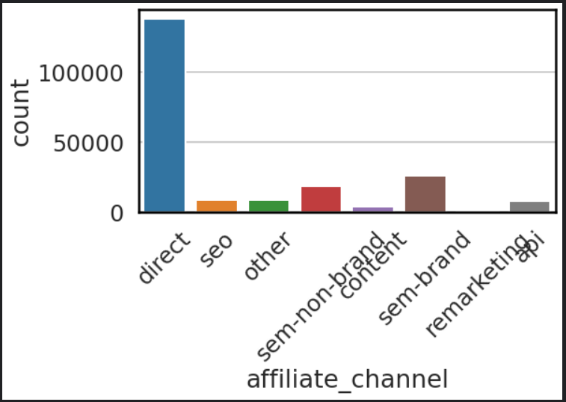
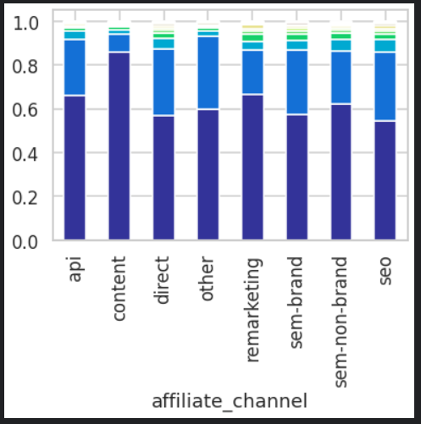
Affiliate channel Feature
What kind of paid marketing.
The Direct Channel has the most number of conversions to bookings whereas the Content Channel has the least.BI7

Slide 26
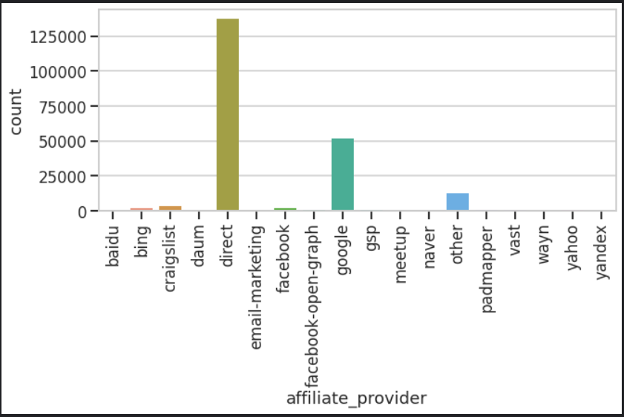
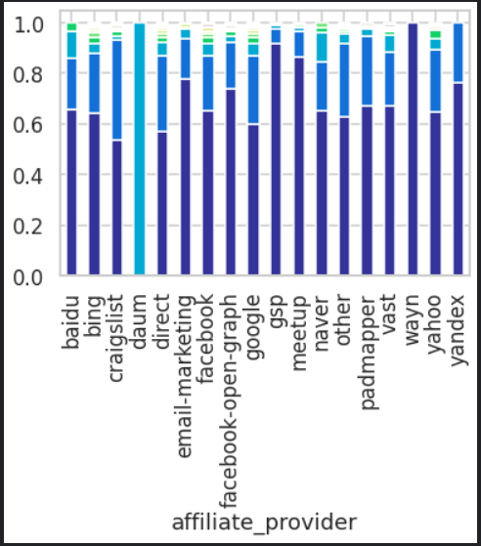
Affiliate provider Feature
Where the marketing is e.g. google, craigslist, other.
Direct and Google are the most popular affiliate providers.
Wayn has the least percentage of conversions whereas Daum has the most.

Slide 27
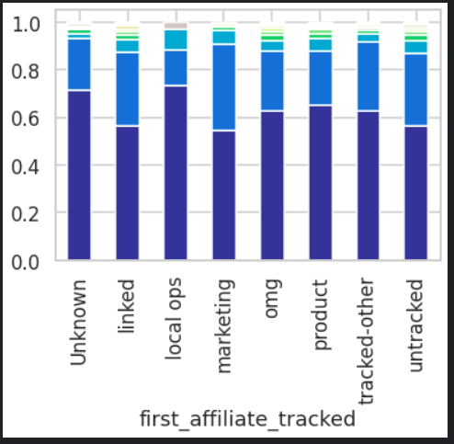
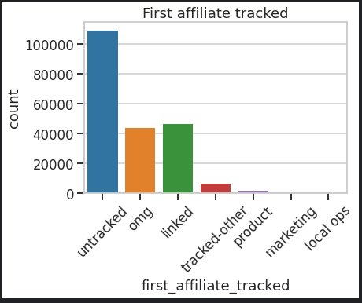
First affiliate tracked
what's the first marketing the user interacted with before the signing up.
People with Marketing affiliates were most likely to book.
People whose first affiliate was tracked as Local Ops or was Unknown were least likely.

Slide 28
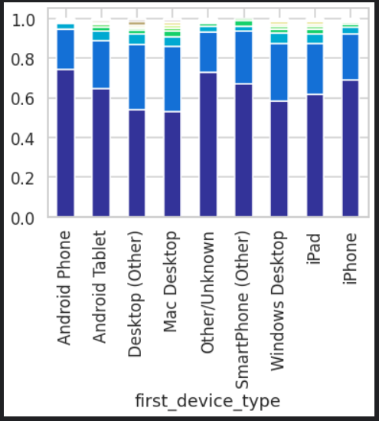
First device type Feature
People with an Android Phone or whose devices were unknown bought fewer Airbnbs.
People on Desktops (Mac or otherwise) bought more. BI3
This strongly suggests that users on their desktop will be more likely to book an Airbnb and Apple Users are more prone to buying on the website whereas Android Users are the least.BI2

Slide 29
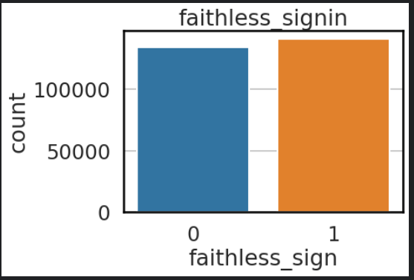
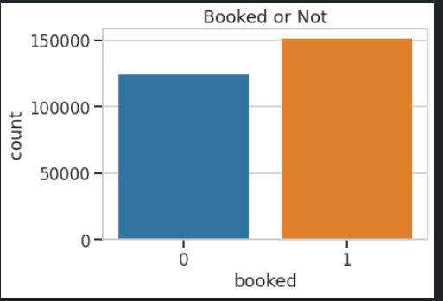
Add Faithless sign in Feature
Create ‘Faithless signin’ feature which indicates the unknown gender and abnormal ages labeled as ‘0’ and ‘1’ for right age, gender data.BI16
See count of which indicates the booked or unbooked Airbnb.

Slide 30
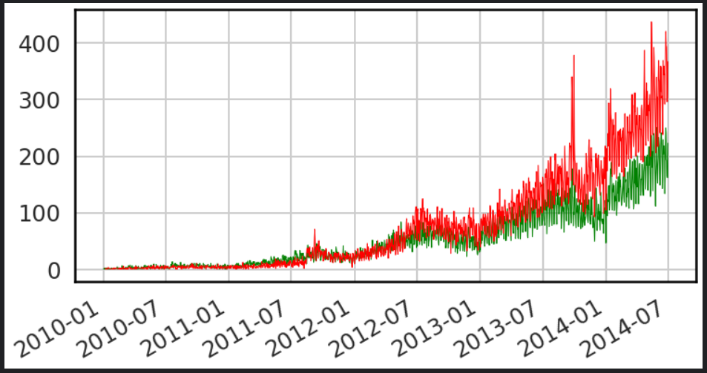
Date account creation
The number of non booking users have increased more than the number of booking users as time passed by.
‘Red’ for haven’t booked and ‘green’ booked.BI5

Slide 31
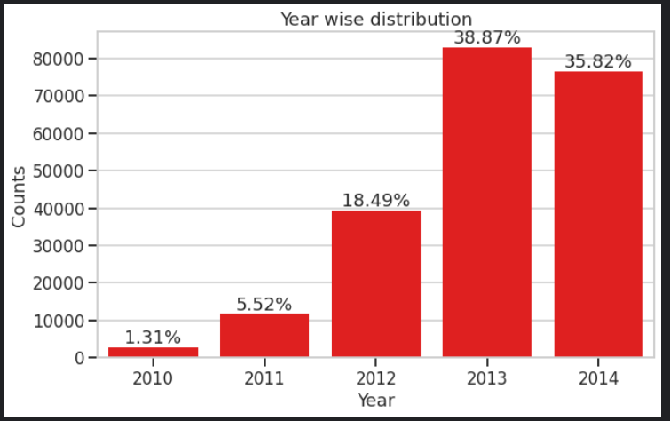
Date account creation
This can be attributed to the fact that more people are using the platform just for exploration.
People Spend A lot of time on the website , the ones who don't book anything spend the least , suggesting that they didn't search good enough or the site wasn't good enough at first glance.BI2
Although There's A Great Increase in Number of New Accounts Created between the years 2013 and 2014 , there is a very slight increase in Bookings that are actually made at the same time period.BI11

Slide 32
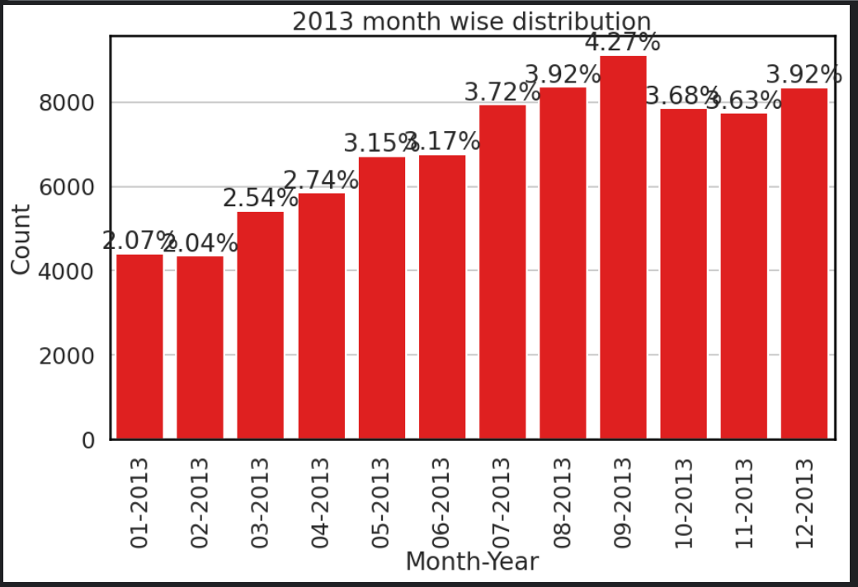
Date account creation
Most Users Create their accounts on July , August and September , with the second half of the year generally larger than the first half.BI3

Slide 33
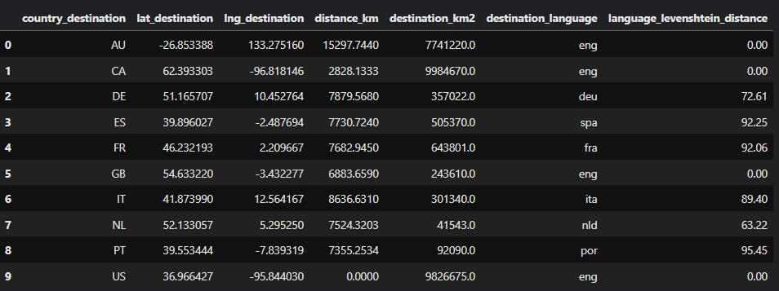
The countries.csv File (10 x 7) shape
Contains summary statistics of destination countries in this dataset and their locations.
As such, we do not need to do any cleaning for this (extremely small) dataset.
The statistics given here to come up with additional insights.

Slide 34
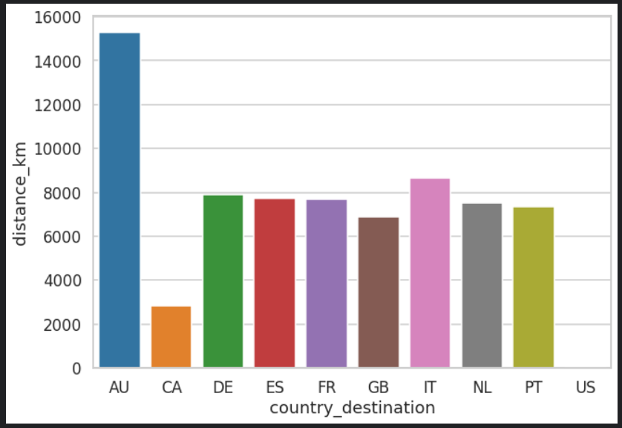
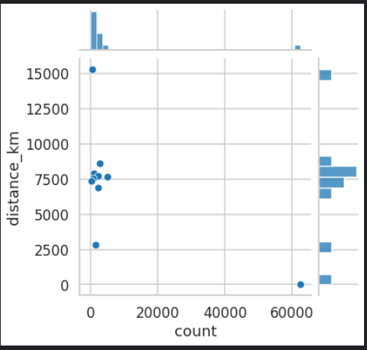
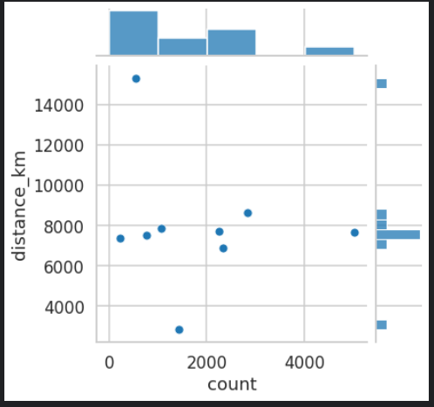
Inferential Statistics
Country_destination vs distance_km.
In country file, we found that the further a country, the less likely people are to visit that particular country.
There must be at least a small negative correlation between these two quantities.BI15

Slide 35
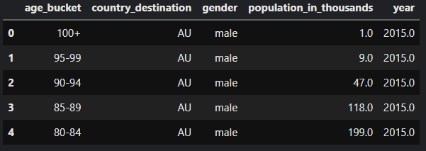
The age_gender_bkts.csv File (420 x 5) shape
This file contains summary statistics of users' age group, gender, country of destination.
This dataset has no null values amongst its features.

Slide 36
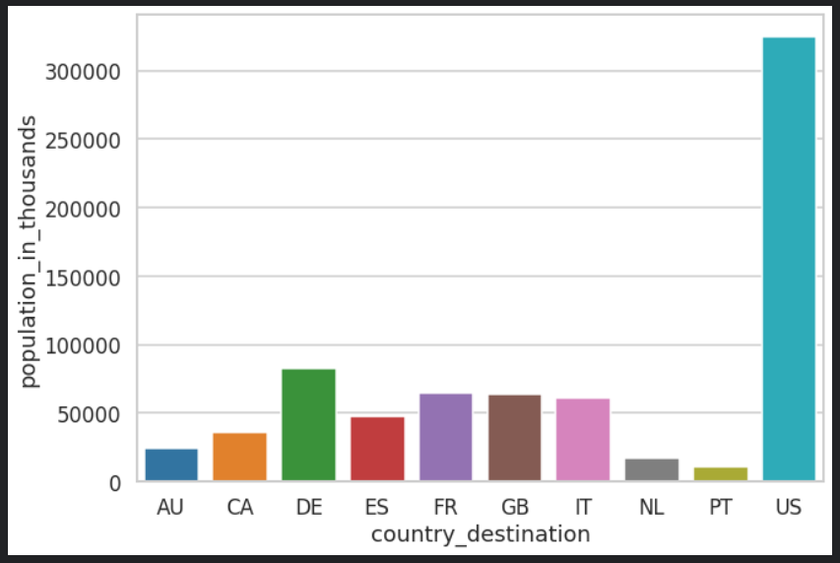
Inferential Statistics
On the age_bucket file, graph the population count in each country.
The US is clearly the most populated nation amongst the destination countries with a population of over 300 million.
All the other countries in the list have a population less than 100 million.

Slide 37
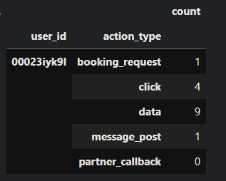
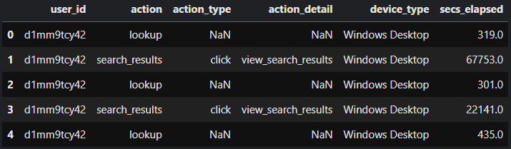
The sessions.csv File (10,567,737 x 6) shape
This file contains all web sessions log for each user.
Take chunks from it to save memory; 10k chunk every time from 10M record.
Then make user_id as the pivot and merge all actions together with their sum count.

Slide 38
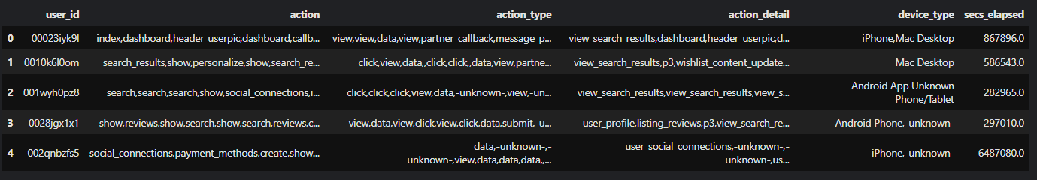
Session file preprocessing
Group df by user_id as it has multiple ids for same user, then list all other features for same unique ones.
For action, action_type and action_details. Remove their nulls and convert their lists to strings separated by comma.
For device_type feature, choose unique types only by set() then remove nulls and convert it also to string separated by comma.
For secs_elapsed feature, removing nulls and convert time to float then sum them for same id.
Finally Merge Users and Sessions tables on ‘id’, then OHE and fill nulls with median.

Slide 39
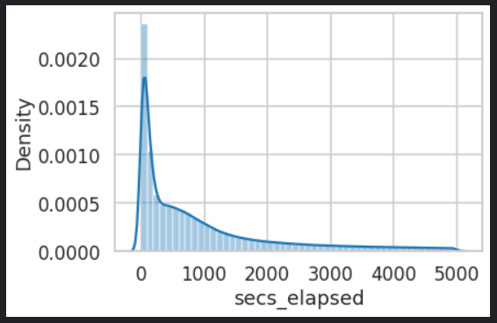
Seconds elapsed feature on session file
Almost 47% of all sessions were less than 1000 seconds long.
This strongly suggests a decreasing exponential distribution of seconds elapsed on each session.
In other words, as the number of seconds increases, the number of instances of sessions requiring that much time exponentially decreases.

Slide 40
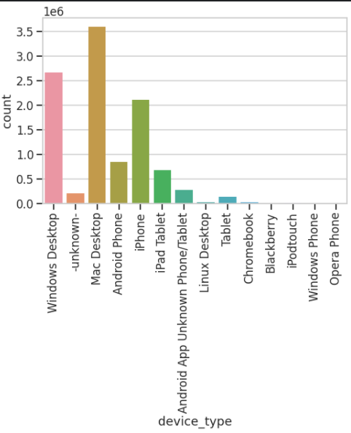
Device type feature on sessions
The Mac Desktop is the most popular device among Airbnb Users, followed by the Windows Desktop.
An interesting insight is that Apple Products are extremely popular with Airbnb Users. The iPhone, iPad and the Mac all appear in the list of top 5 most popular devices.

Slide 41
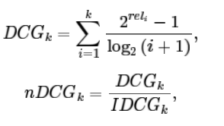
Evaluation metric
NDCG (Normalized discounted cumulative gain) @k where k=5. NDCG is calculated as:
For each new user, you are to make a maximum of 5 predictions on the country of the first booking. The ground truth country is marked with relevance = 1, while the rest have relevance = 0.
This metric is used for Recommendation engine, web search and Search engine.

Slide 42
ML Modeling
Split data stratified into train, validate and test.
Make label encoder transformation for the target as it is categorical.
Select the model and tune its parameters to get best fit.
After data preparation, perform Min-Max Scaling as data is skewed. Then start running the model, analyze the result and tweak the approach.
This is an iterative step until the best possible outcome is achieved.
Reverse transformation of target and make validate the model using a unseen test data.
Start implementing the model and track the result to analyze the performance of the model over the period of time.

Slide 43
ML Modeling
Due to the Imbalancing exists on the data and its categorical nature with large dataset and high dimensionality results from merging data frames together. So choose ml model which has the capability to deal with these factors and also be fast.
So after searching and trails, Finally worked with Light Gradient Boost LGBM Classifier, Extreme Gradient Boost Classifier and cat Boost Classifier.
After building the model and fine tune it to suit the data entered to it, here are the results.
CGBC get results higher than XGBC and LGBC.

Slide 44
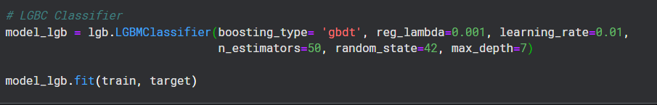
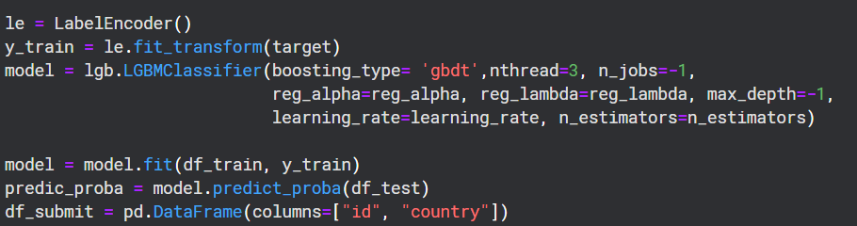
LGBM Classifier
The model got 87.601% accuracy on private score after submission within 6 mins.

Slide 45
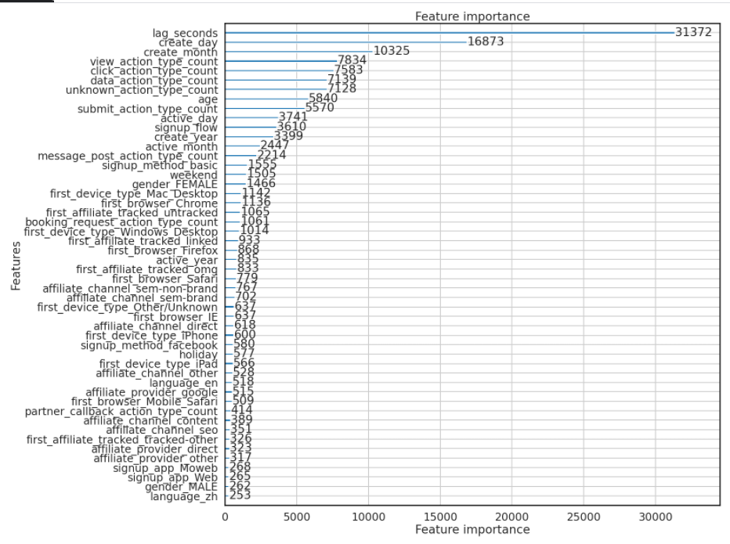
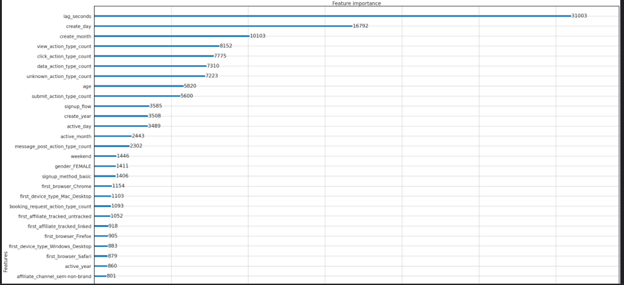
Feature Importance for LGBMClassifier

Slide 46
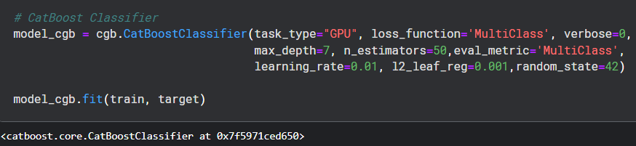

CatBoost Classifier
The model got 87.734% accuracy on private score after submission Within 7 mins.

Slide 47

XGBoost Classifier
The model got 87.645% accuracy on private score after submission within 17 mins.

Slide 48

Feature Importance for XGBoost Classifier

Slide 49
Final Business Recommendations
Advertise to attract more Non-English Speaking Users,and more Non-US Citizens Users.
Prioritize the App on IOS And the User Experience On Mac Products in General.BI2
Give Discounts/offers on the first half of the year to increase reservations.BI3
Add More services To attract More People, the bigger portion of the users don't do any reservations at all after signing up .BI4
Make The App More Appealing and Easy to use , increase Number of reservations to time spent on the website ratio. Targeting a lot of wrong people.BI5
Investigate Behaviour of Users Who book for france And Italy Because they Spend a lot of time on the website Compared to other Users.BI6
BI1

Slide 50
Final Business Recommendations
Advertise More Online, As the Majority of the subscription come from a direct way not through any marketing agency.BI7
Add More Advertising To Youth from Age Group 18 to 24.BI8
Increase Attractions for Tourists : Most Users Are of High Age Group (40+) , this may indicate the service being used more for business purposes than tourism.BI9
Make it Mandatory (if it's not against Policies of the company) To Fill the Gender Data.BI10
Continue Using Policies that were used in late 2013 & early 2014 as they show a great increase in the Number of Accounts Created.BI11
Investigate Why Users Joined in 2014 Didn't do a lot of reservations.BI12

Slide 51
Final Business Recommendations
People use smaller devices for surfing and exploration and desktops to make the actual booking.BI13
The User Experience for the apps on different devices must be tuned accordingly to achieve best results. BI14
Most of the Airbnb Users tend to book an Airbnb within the country. Therefore, it makes most sense to give the users more recommendations that are endemic to the country. BI15
People who haven't filled out their information such as Age and Gender are the least likely to book Airbnbs. This is likely due to the fact that they are only in the exploration stage. BI16

Slide 52
Thanks for your time
max growth

